Slide 1

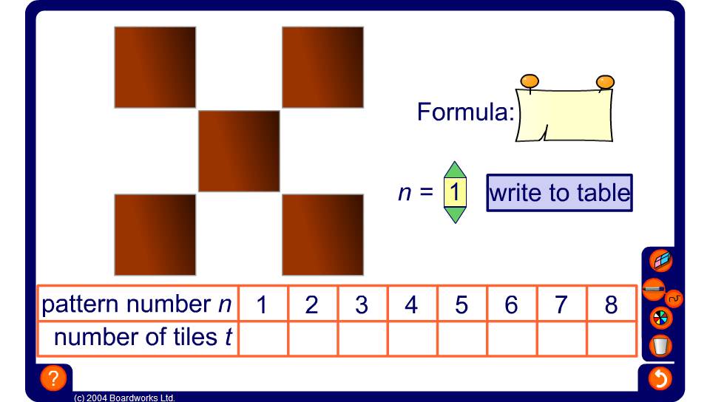

Dotty patterns
Notes:
By changing n and recording the results in the table ask pupils to derive a formula to give the number of tiles given the pattern number.
Ask pupils to justify the formula in the context from which it is generated. Each time n increases a square n tiles by n tiles is produced, this is where the n² part of the formula comes from. There are always 4 more tiles around the outside of the pattern, this is where the + 4 part of the formula comes from.

Slide 2
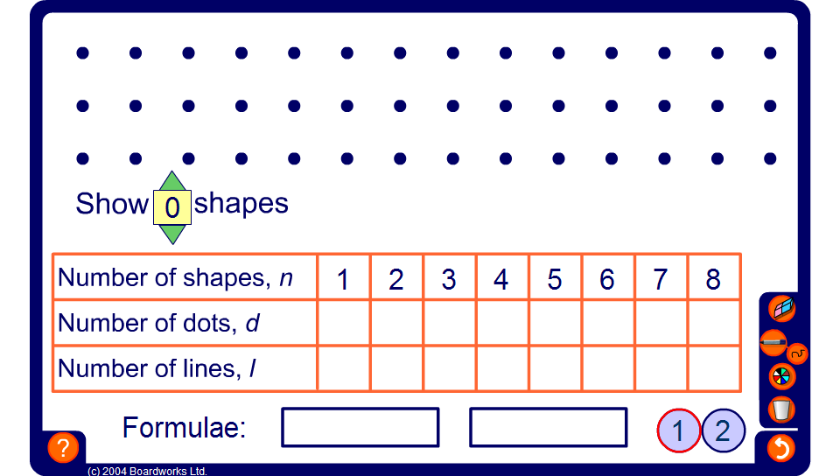

Dotty pattern 1
Notes:
Gabby is drawing patterns on square dotty paper. For each shape in the pattern she writes down the number of dots she passes through and the number of lines connecting the dots. She puts her results in a table.
Use the slider to demonstrate different numbers of shapes and ask pupils to tell you the number of dots and the number of lines used.
Enter these values into the table.
After a few values have been entered ask pupils to predict the remaining values. Ask pupils how they made their predictions.
Establish that for every shape we add on, we add another 3 dots and another 4 lines. Encourage pupils to justify these rules within the context of the pattern.
The term-to-term rule for the sequence formed by the number of dots is ‘add 3’ and the term-to-term rule for the sequence formed by the number of lines is ‘add 4’.
Ask pupils, How many dots will there be if n shapes are drawn?
Remind pupils again that that n can be any whole number. Ask them, What do you do to the number of shapes, n, to get the number of dots?
Establish that since the sequence is formed by adding 3 each time, like the three times table, the rule for the n^{th} term must be based on 3n.
Ask pupils to mentally multiply some of the shape numbers by 3 and ask them what they need to add on to get the number of dots. For example, if there are 5 shapes, three times 5 is 15. We then need to add 2 to get 17.
By going through more examples establish that the rule for the n^{th} term of the sequence formed by the number of dots is: 3n + 2.
Give a verbal justification of the rule. For example, for every shape we use 3 dots, hence the 3n. There are another two dots in the first shape, hence the + 2.
Using similar arguments establish that the rule for the n^{th} term of the sequence formed by the number of lines is: 4n + 1 and click in the corresponding cell to reveal this in the table.
Click to reveal the formulae for the number of dots, d and the number of lines, l.

